Slide 1


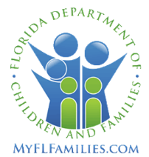

CBC Performance and Quality Improvement Packet
Data for Week Ended Sunday, June 25, 2023
Circuit 10 – Central Region

Slide 2
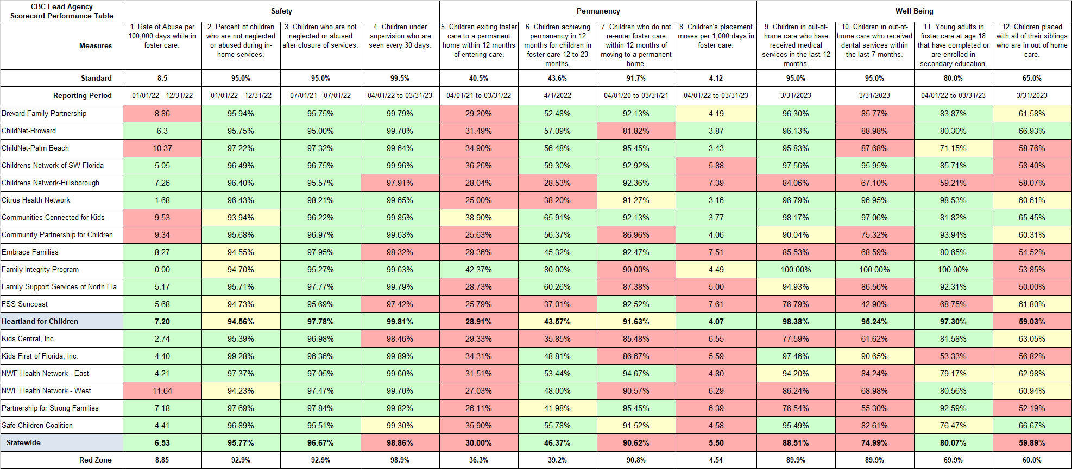
Community Based Care Lead Agency Scorecard
FY 22-23, 3rd Quarter: January 01, 2023 to March 31, 2023
2

Slide 3

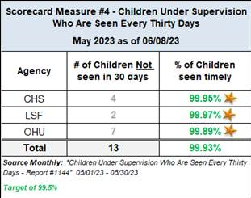
Scorecard Measure 4 – Children Seen Every Thirty Days
SM04 - Percent of children under supervision who are required to be seen every 30 days – Target = 99.5%
Current Month
Prior
Month End
3

Slide 4
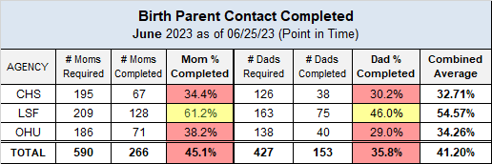
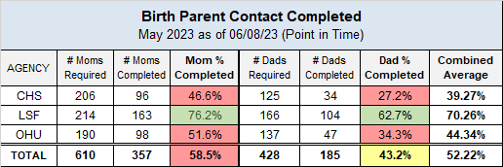

Monthly Birth Parent Contacts
Target = 70% Mothers and 50% Fathers - seen monthly
Current Month
Mother Contact
Green: 70% or above, Yellow: 69% - 60%, Red: 59% or less
Father Contact
Green: 50% or above, Yellow: 49% - 40%, Red: 39% or less
Prior
Month End
Mother Contact
Green: 70% or above, Yellow: 69% - 60%, Red: 59% or less
Father Contact
Green: 50% or above, Yellow: 49% - 40%, Red: 39% or less
4

Slide 5
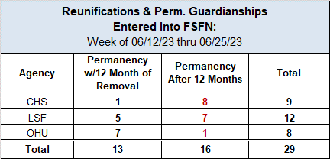
Scorecard Measures 5 & 6 - Children Achieving Permanency
SM05 - Percent of children exiting care to a permanent home within 12 months of entering care – Target = 40.5%
SM06 - Percent of children exiting care to a permanent home for children in care 12-23 months – Target = 43.6%
Entered into FSFN
Last 2 Weeks
SM05 - Percentage to reach Yellow = 36.5%
SM06 - Percentage to reach Yellow = 39.4%
Source: Children Exiting Out-of-Home Care to a Permanent Home within Twelve Months of Entering Care On-Demand Listing - Report #1119
Source: Children Exiting Out-of-Home Care to a Permanent Home within Twelve Months of Entering Care On-Demand Listing - Report #1138
5

Slide 6
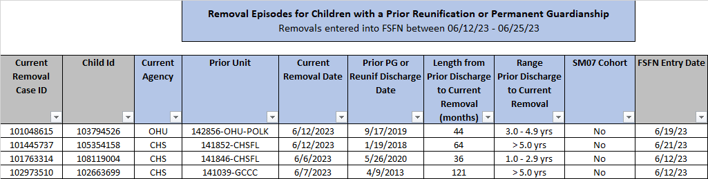
Children Re-Entering Out-of-Home Care
Number of Children in a Recent Removal Episode Who Have Had a Prior Reunification or Permanent Guardianship
Re-Entry into OHC
Last 2 Weeks
Source: FSFN Data Warehouse Ad Hoc Report, Rpt-as-of: 06/25/23
Scorecard Measures 7 – Children Who Do Not Re-Enter into OHC after Achieving Permanency
SM07 - Percent of children exiting care to a permanent home within 12 months of entering care – Target = 91.7% or Greater
FY 22/23
Contract Measure
Source: Children Who Do Not Re-Enter Foster Care within Twelve (12) Months of Moving to a Permanent Home On-Demand Listing - OCWDRU Report #1100 , Rpt-as-of: 06/26/23
6

Slide 7
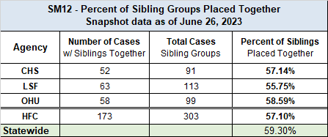
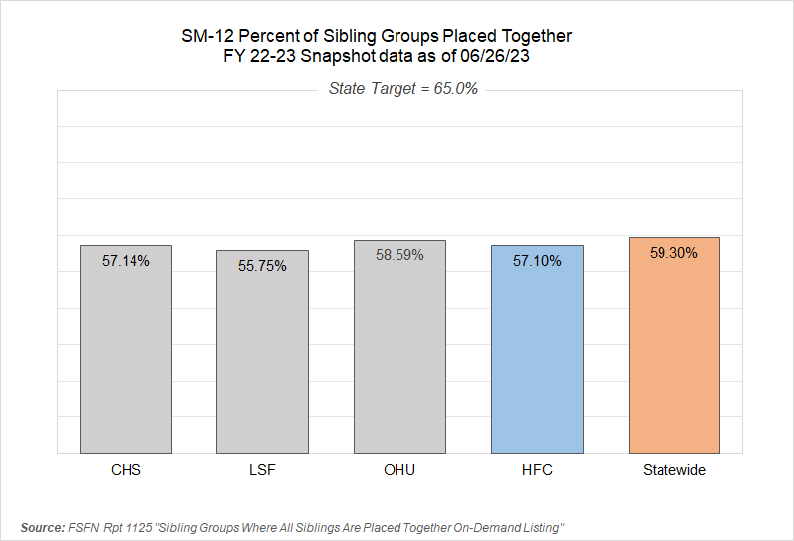
Scorecard Measure 12 – Separated Siblings
SM12 - Percentage of siblings groups in out-of-home care where all siblings are placed together – Target = 65.0%
Number of sibling groups to achieve SM12 target – 26 Sibling Groups
7

Slide 8
Adoption Finalizations
Percent of Adoptions Finalized with 24 Months of Removal & Percent of Adoption Goal Met
Upcoming Finalization Dates
- June 28, 2023
- July 19 & 26, 2023
- August 16 & 23, 2023
8

Slide 9
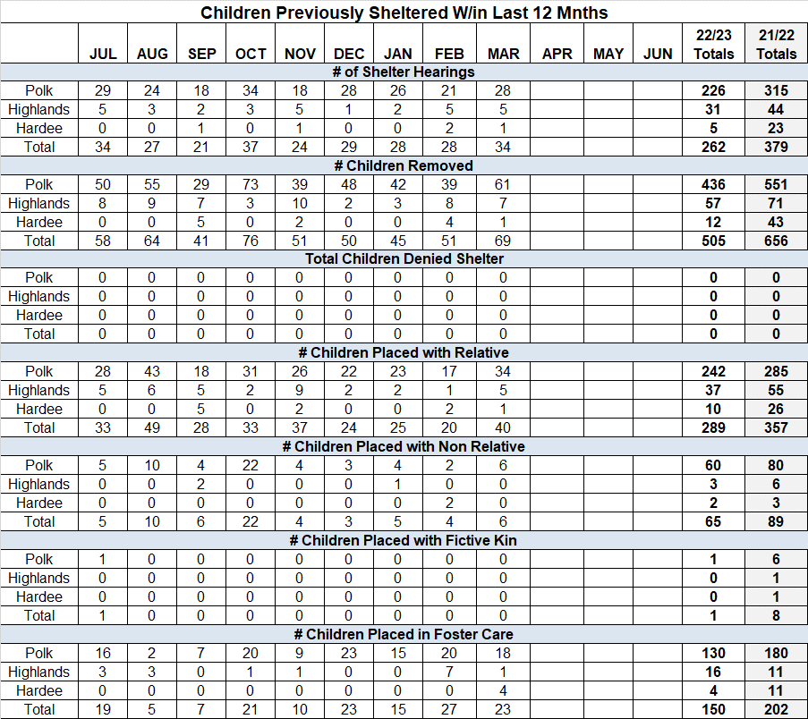
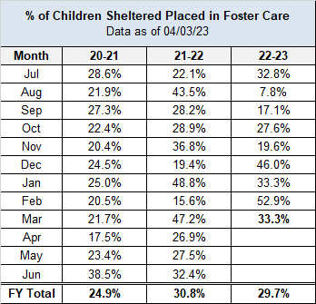
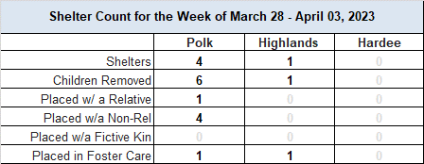
Children’s Legal Services – Shelter Report
CLS Weekly Shelter Report FY 2022-23 as of April 03, 2023
9

Slide 10
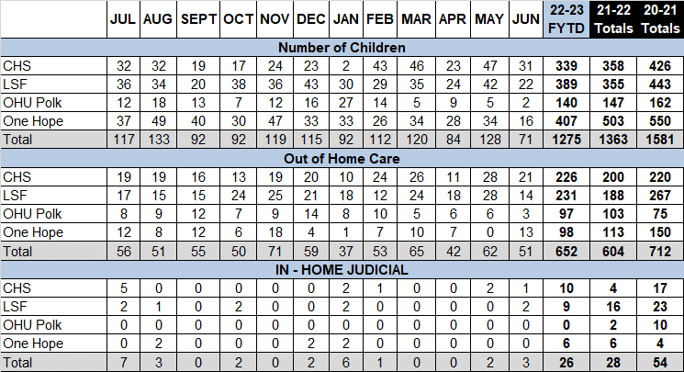
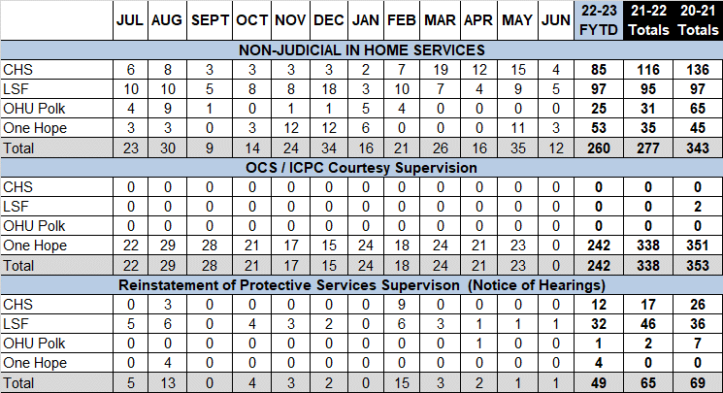
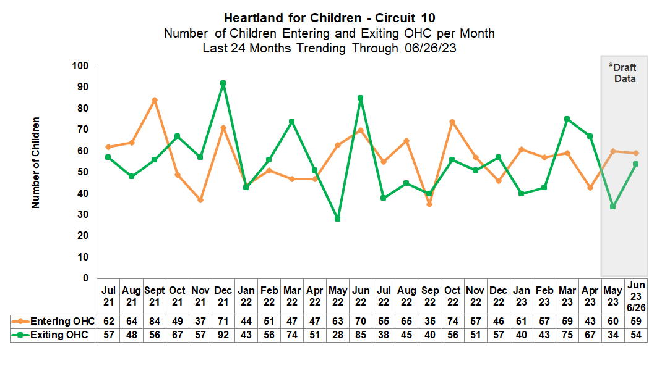
Case Transfer Staffing Data
Case Transfer Data For Fiscal Year July 1, 2022 – June 30, 2023 - Data as of 06/25/23
Children Entering & Exiting Care
Number of Children Entering and Exiting Out-of-Home Care per Month
Source: Children Entering and Exiting Foster Care On-Demand Listing - OCWDRU Report #1182,
Report-as-of: 06/26/23
Including Children Aged 0-17
10

Slide 11

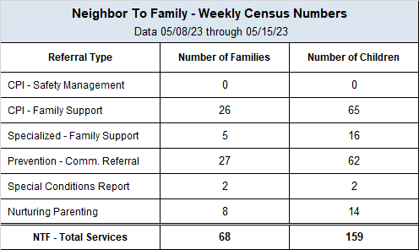
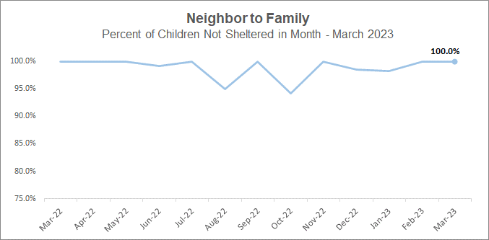
Neighbor to Family – Weekly & Monthly Census
22-23 Fiscal Year to Month - Percentage of Children Not Sheltered: 95.9%
“Very supportive and extremely helpful when it came to asking questions.”
- NTF Parent Satisfaction Survey– Q: What we are doing well?
11

Slide 12
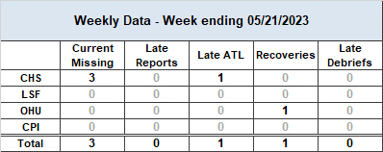
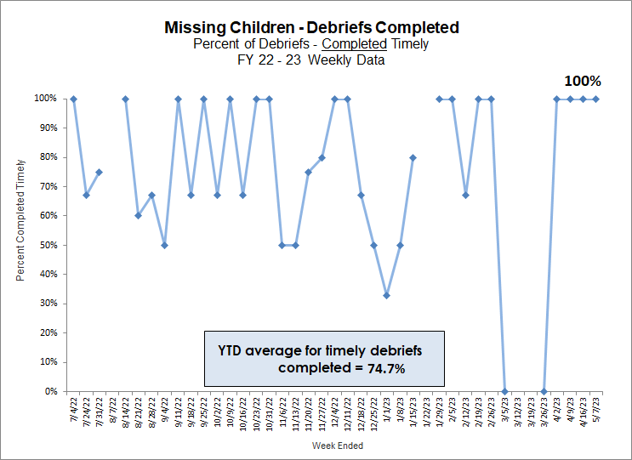
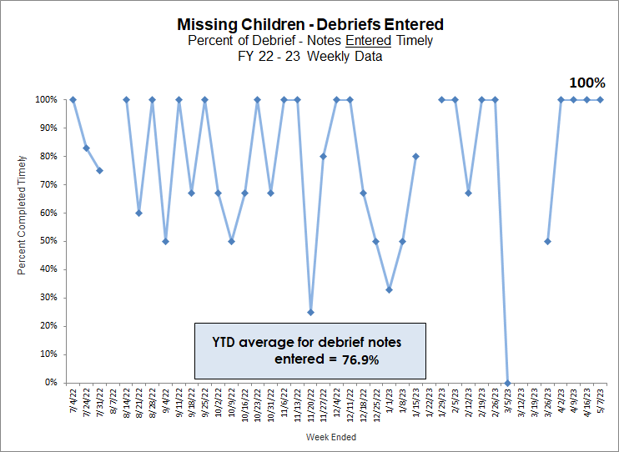
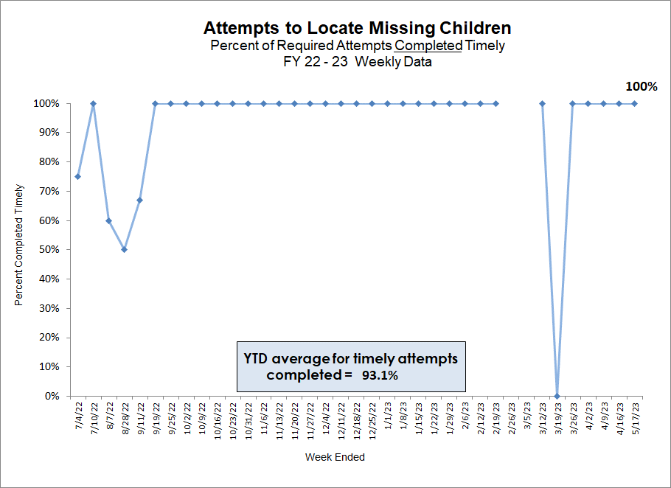
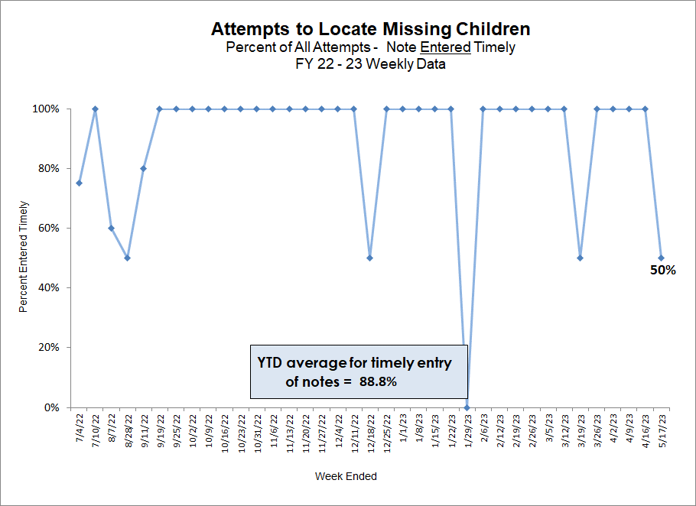
Missing Children
HFC – DCF Circuit 10 Missing Youth Data as of Reporting Date
12

Slide 13
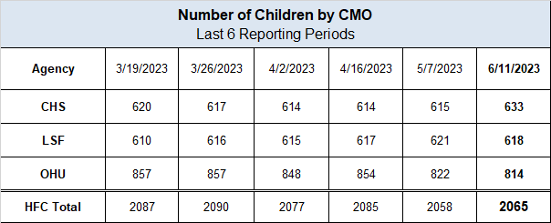
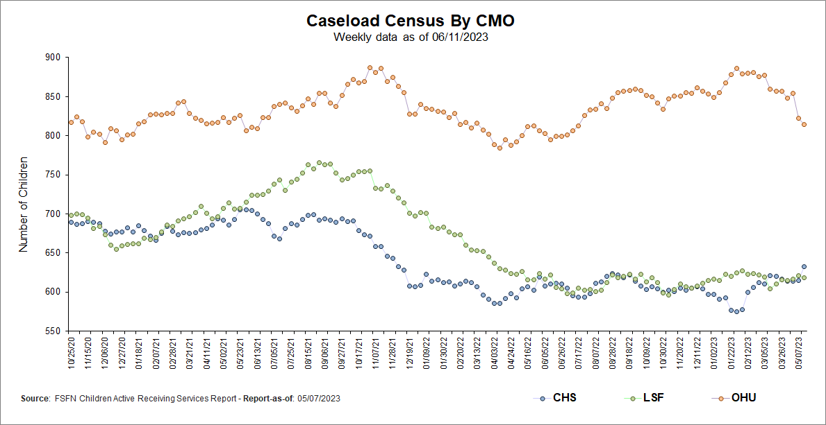
Caseload Census Information
CBC Services Weekly Caseloads By CMO
13

Slide 14
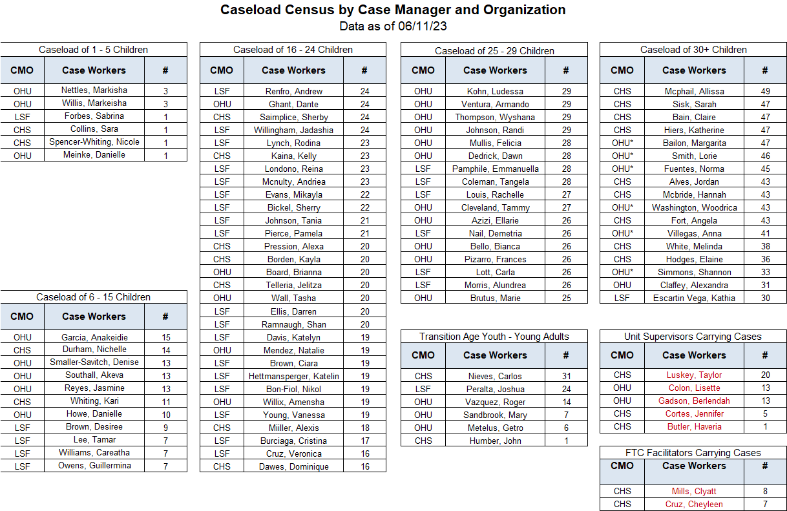
*These OHU case managers contain caseloads that are over 65% OCS cases. On average an OCS case compares to 1.54 regular cases (i.e., 20 OCS cases approx. equals 13 regular cases).
All CHS case managers are supported by Case-Aim support. On average a Case-Aim supported case compares to 1.33 regular cases (i.e., 20 cases with Case-Aim approx. equals 15 cases without Case-Aim support).
Red = Supervisors, FTC Facilitators & Resigned CMs carrying cases
14

Slide 15
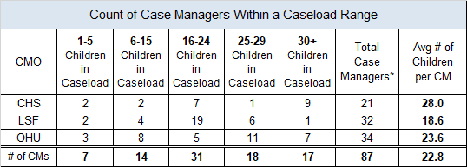
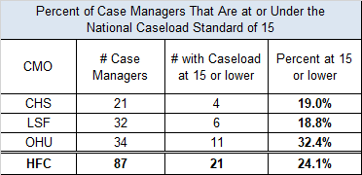
Caseload Census Information
Case Manager Caseload Breakdown by Agency – Data as of 06/11/23
* Data Excludes Unit Supervisors, FTC Facilitators & Resigned CMs Count
Case Management Organization Turnover
12 Month Case Manager Turnover Rates by Agency
7/2/22 - Transition from Devereux to Lutheran Services Florida; the 12-months required for a “Rolling Year Total” has been split between agencies:
DEV: Mar-22 to Jun-22 (4 months)
LSF: Jul-22 to Feb-23 (8 months)
15

Slide 16
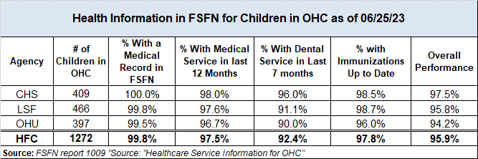
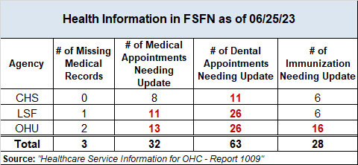
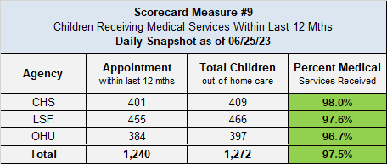
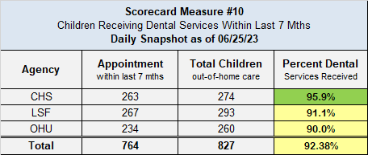
Healthcare Information
Data Entered Into FSFN for Children in Out-of-Home Care
Scorecard Measures 9 & 10 - Children Receiving Healthcare Services
SM 9 - Percent of children in out-of-home care who have received medical services in the last 12 months – Target = 95%
SM 10 - Percent of children in out-of-home care who have received dental services in the last 7 months – Target = 95%
16

Slide 17
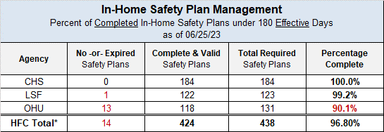
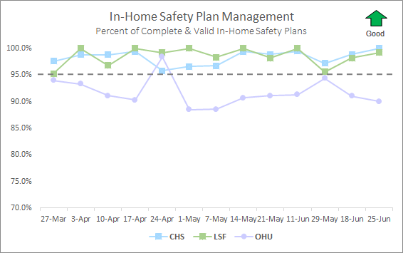
In-Home Safety Plan Management
Percent of Completed In-Home Safety Plans under 180 Effective Days – Target: 95.0%
Source: FSFN Report 1301 “Case Management Safety Management Listing”
17

Slide 18
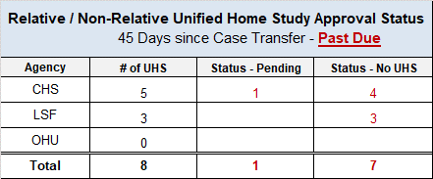
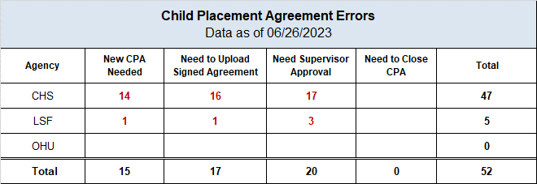
Unified Home Studies – Approval Status
Cases with a Pending or No UHS – 45+ Days Past Due; Data-as-of: 06/26/2023
Child Placement Agreement Errors – Data-as-of: 06/26/2023
18

Slide 19
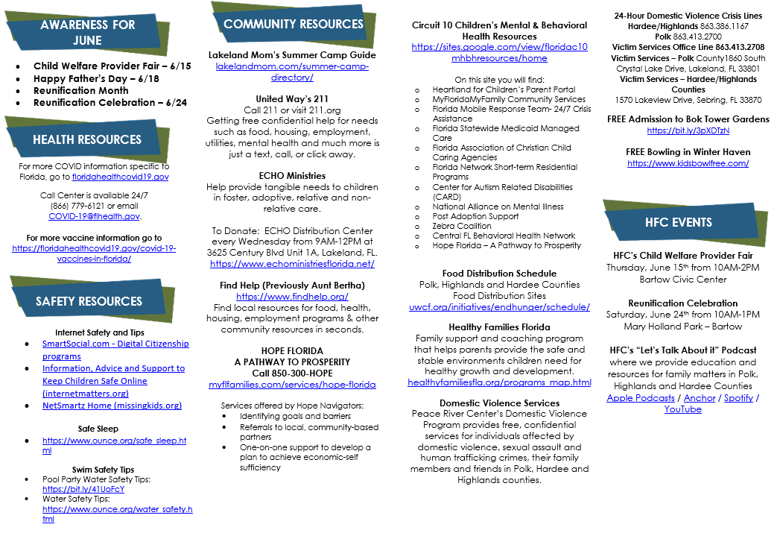
19

Slide 20
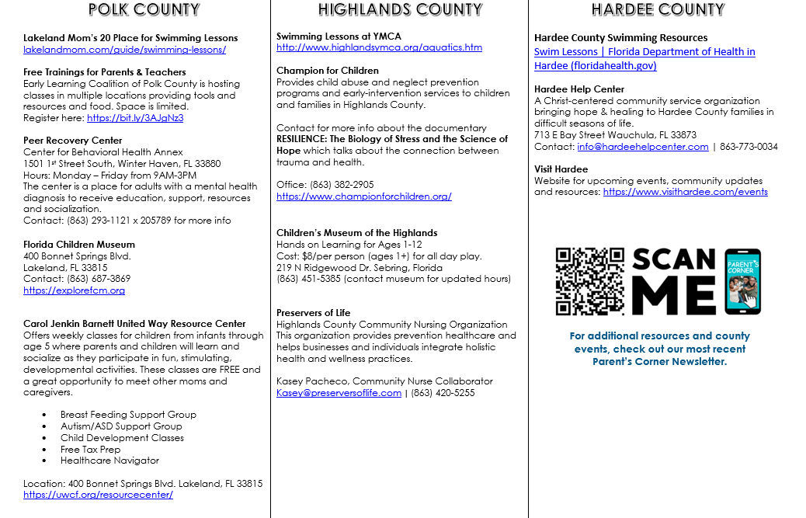
20

Slide 21
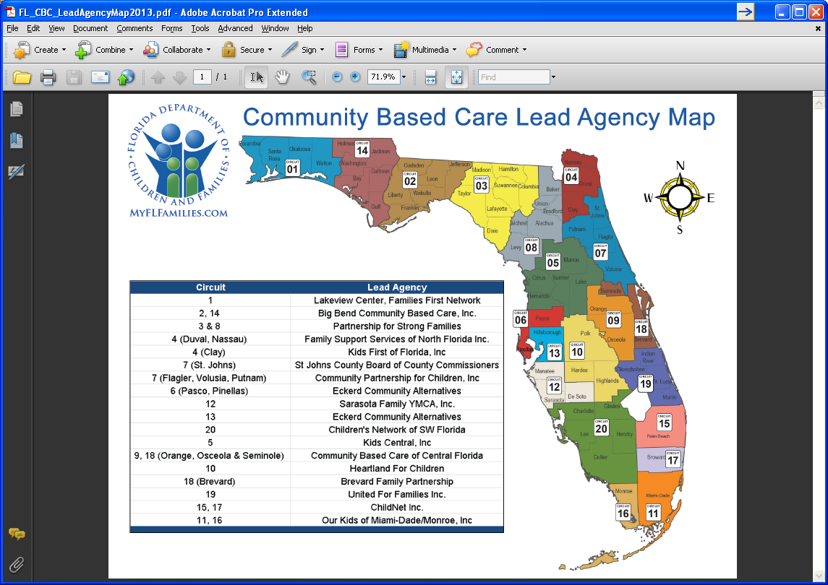
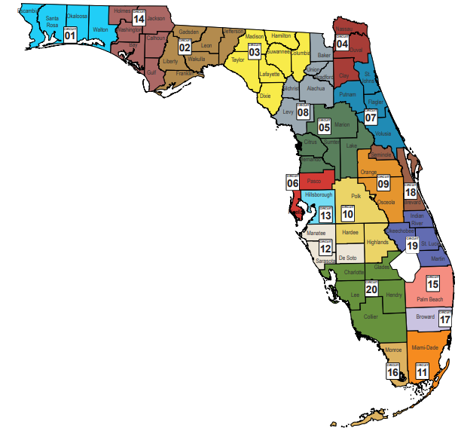
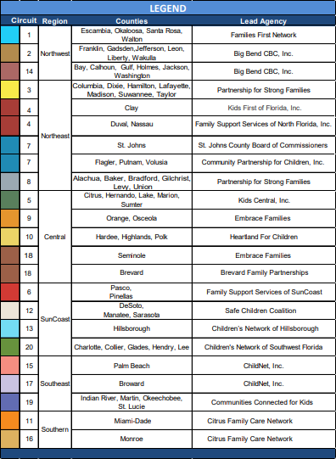
21

