Slide 1
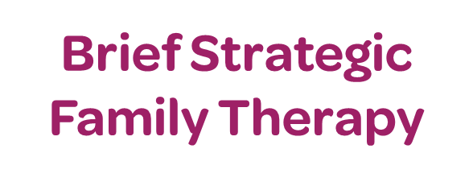



Fast and Effective
Evidenced Based Intervention
A structured family systems approach to treat families with children or adolescents (6 to 17 years) who display or are at risk for developing problem behaviors including substance abuse, conduct problems, and delinquency.
Brief Strategic Family Therapy reduces behavioral problems and drug use in children and adolescents and strengthens the family unit. It is a structured, problem-focused, directive, and practical approach
BSFT is typically delivered in 12 to 16 weekly sessions based on individual and family needs.
•75% reduction in drug use
•75% of families remained in the program in its entirety
•58% reduction in association with antisocial peers
•42% improvement in conduct disorder
Referrals are submitted and received through Mindshare.
Children’s Home Society of Florida | (863) 413-3126
1010 East Rose Street | Lakeland, FL 33801 | https://chsfl.org/make-a-referral/

